Slide 1
A Study Of
The Book Of Revelation
April 25, 2021

Slide 2
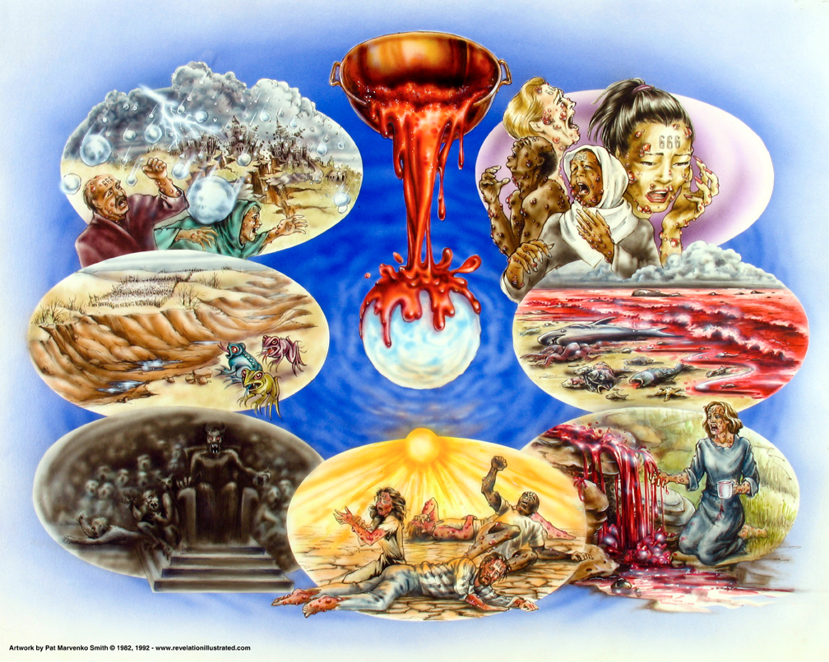
Book of Revelation:
Chapter 16
Revelation 16
Bowls of Wrath—
Judgment Complete

Slide 3

Revelation 16:1
Revelation 16
“And I heard a great voice out of the temple, saying to the seven angels, Go ye, and pour out the seven bowls of the wrath of God into the earth.”

Slide 4
Revelation 16
Trumpets
Fire, blood on earth (8:7)
Sea – Blood (8:10)
Fountains bitter (8:10)
Sun, Moon Darkened (8:12)
Smoke, Locust (9:1-4)
Angels of Euphrates (9:14)
Mystery finished (10:7)
Trumpets: Warn-
Third part destroyed
Bowls
On earth, sores (16:2)
On the sea (16:3)
Rivers – blood (16:8)
Sun scorched (16:8)
Darkness (16:10)
Euphrates dried (16:12)
Finished; hail (16:17)
Bowls: Finality of Judgment
Plagues
Boils (Ex. 9:9-11)
Water – Blood (7:17-21)
Darkness (10:21-23)
Locusts (10:4)
Hail (9:19-24)
(Frank Jamerson, 1994 Florida College Lectures, page 132)

Slide 5
The Commission
Revelation 16
No partial judgment.
  cf. Revelation 8:6ff – Trumpets sounded.
The wrath/plagues find their background in the plagues of God on Egypt.
Climax of the apocalypse.
The final judgment of God against a wicked agent of Satan is about to be revealed.
Not the final judgment of all the world.

Slide 6
The Commission
Revelation 16
“Voice from the temple” (loud) — must be God since no one else is in there
Spoken to the seven angels
“Go … pour out” – “into the earth”
Warning is gone
The fury of God
God’s patience is now over

Slide 7
Revelation 16:2
Revelation 16
“And the first went, and poured out his bowl into the earth; and it became a noisome and grievous sore upon the men that had the mark of the beast, and that worshipped his image.”

Slide 8
The First Bowl Poured out
Revelation 16
These would not affect the Christians
Incurable disease (like the 6th plague in Egypt – Exodus 9:10ff)
Affected those who “worshipped the beast” and those with the “mark of the beast”
Poured out on the same objects of nature of those the of the four trumpets.

Slide 9
The First Bowl Poured out
Revelation 16
Three underlying reasons for Rome’s downfall:
  Natural disasters
  Social decay
  External invasions
  Three objects affected by the trumpets and now repeated by the bowls
  Symbolism reminds those persecuted – Rome would fall in time – by God’s timetable!

Slide 10
Revelation 16:3
Revelation 16
“And the second poured out his bowl into the sea; and it became blood as of a dead man; and every living soul died, (even) the things that were in the sea.”

Slide 11
The Second Bowl Poured out
Revelation 16
Into the sea
Blood (Exodus 7:17-21)
Here, it is literally, “blood of a dead man,” (not fresh) and NOT the blood of dead man.
Water is one of man’s basic requirements
Polluted water causes endangerment
Second trumpet (8:8-9) – maritime disaster warning

Slide 12
Revelation 16:4
Revelation 16
“And the third poured out his bowl into the rivers and the fountains of the waters; and it became blood.”

Slide 13
Revelation 16:5
Revelation 16
“And I heard the angel of the waters saying, Righteous art thou, who art and who wast, thou Holy One, because thou didst thus judge”

Slide 14
Revelation 16:6
Revelation 16
“for they poured out the blood of the saints and the prophets, and blood hast thou given them to drink: they are worthy.”

Slide 15
Revelation 16:7
Revelation 16
“And I heard the altar saying, Yea, O Lord God, the Almighty, true and righteous are thy judgments.”

Slide 16
The Third Bowl Poured out
Revelation 16
“Into rivers and springs of water”
Fresh, as well as salt water, stank with death as they turned to blood
Men on earth reaping what they had sown
Blood — judgment declared to be righteous
Confirmed by this angel
Righteous because of the blood of martyrs shed by Rome
Made their blood run as water (17:6) and now all they have to drink is blood!

Slide 17
The Third Bowl Poured out
Revelation 16
Deserve God’s wrath because of rejection of truth and shedding the blood of the bearers of that truth
The martyrs under the altar, asking for vindication earlier
The “altar” represents as replying to praise the event.
Punishment fits the crime
Rome is worthy of torment for her conduct.

Slide 18
Revelation 16:8
Revelation 16
“And the fourth poured out his bowl upon the sun; and it was given unto it to scorch men with fire.”

Slide 19
Revelation 16:9
Revelation 16
“And men were scorched with great heat: and they blasphemed the name of God who hath the power over these plagues; and they repented not to give him glory.”

Slide 20
The Fourth Bowl Poured out
Revelation 16
Horrible effect on the sun
Intensified on the non-Christians
Frightening picture of torment of sinners
Fiery trial now for the non-Christian
Blasphemy and impenitence — fiery trial had hardened their hearts
First four bowls happens quickly — did not move them to repent
So far into sin — can’t repent (Hebrews 6:6)

Slide 21
Revelation 16:10
Revelation 16
“And the fifth poured out his bowl upon the throne of the beast; and his kingdom was darkened; and they gnawed their tongues for pain”

Slide 22
Revelation 16:11
Revelation 16
“and they blasphemed the God of heaven because of their pains and their sores; and they repented not of their works.”

Slide 23
The Fifth Bowl Poured out
Revelation 16
The first four bowls affected the earth in general, the fifth affects only the beast’s throne and kingdom.
Beast’s kingdom is darkened
The very seat of authority is attacked — the “throne”
In darkness and the pain — things getting pretty rough
Again they become impenitent and blasphemous — hearts getting harder

Slide 24
The Fifth Bowl Poured out
Revelation 16
Center of the empire of Rome
Rome’s weakening, and diminishing of Rome’s stranglehold on the world
Difficulties of this magnitude have caused humble men to recognize their errors and repent
Compound their sinfulness
Unfortunately, sinful pleasures had led to internal rottenness.

Slide 25
Revelation 16:12
Revelation 16
“And the sixth poured out his bowl upon the great river, the (river) Euphrates; and the water thereof was dried up, that the way might be made ready for the kings that (come) from the sunrising.”

Slide 26
The Sixth Bowl Poured out
Revelation 16
River Euphrates is no longer an obstacle to invading armies (cf. capture of ancient Babylon by Cyrus, Jeremiah 50:38; 51:36-37)
Rome’s greatest fears are going to materialize
Army of God will bring pagan Rome to her knees
Unable to protect itself from outside invaders, such as Parthians from the east.

